Slide 1
The Operational Amplifier (Chapter 5)
Textbook:
Electric Circuits
James W. Nilsson & Susan A. Riedel
9th Edition.

Slide 2
Objectives
Be able to name the five op amp terminals, and describe and use the voltage and current constraints of an ideal op amp.
Be able to analyze simple circuits containing ideal op amps, and recognize the following op amp circuits: inverting amplifier, summing amplifier, non inverting amplifier, and difference amplifier.
Understand the more realistic model for an op amp.

Slide 3

Outline
Operational amplifier terminals
Terminal voltages and currents
The inverting-amplifier circuit
The summing-amplifier circuit
The non inverting-amplifier circuit
The difference-amplifier circuit

Slide 4
Op Amps
Op Amp <==> operational amplifier.
An Op Amp is modeled as a voltage controlled voltage source.
An operational amplifier has a very high input impedance and a very high gain.
Op amps can be configured in many different ways using resistors and other components.
Most configurations use feedback.

Slide 5
Applications of Op Amps
Amplifiers provide gains in voltage or current.
Op amps can convert current to voltage.
Op amps can provide a buffer between two circuits.
Op amps can be used to implement integrators and differentiators.
Lowpass and bandpass filters.

Slide 6
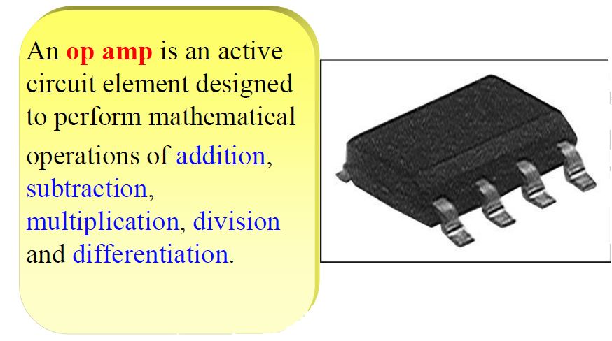
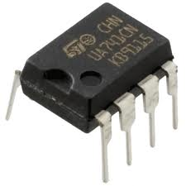
Applications of Op Amps

Slide 7
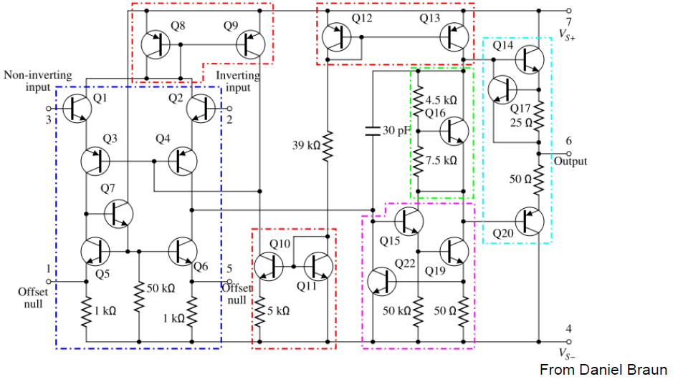
Internal Circuit of 741 Type Op Amp
A component level diagram of the common 741 op-amp. Dotted lines outline: current mirrors(red); differential amplifier(blue); class A gain stage (magenta); voltage level shifter (green); output stage (cyan).

Slide 8
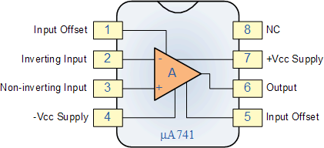
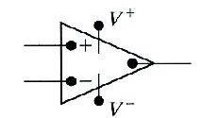
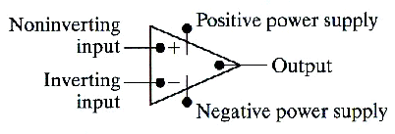
Op Amp Terminals
Terminals of primary interest:
inverting input
noninverting input
output
positive power supply (+Vcc)
negative power supply (-Vcc)
Offset null terminals may be used to compensate for a degradation in performance because of aging and imperfections.

Slide 9
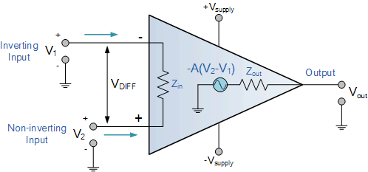
The Op Amp Model
An operational amplifier is modeled as a voltage-controlled voltage source.
A(V₂ - V₁)

Slide 10
Typical vs. Ideal Op Amps
Typical Op Amp:
The input resistance (impedance) R_{in} is very large (practically infinite).
The voltage gain A is very large (practically infinite).
Ideal Op Amp:
The input resistance is infinite.
The gain is infinite.
The op amp is in a negative feedback configuration.

Slide 11
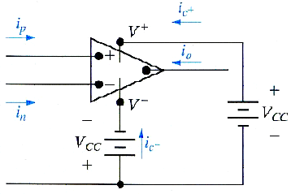
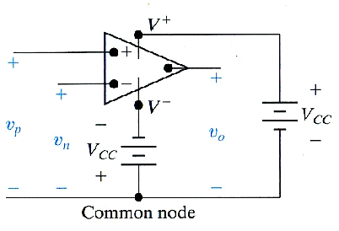
Terminal Voltages and Currents
Terminal voltage variables
Terminal current variables
All voltages are considered as voltages rises from the common node.
All current reference directions are into the terminal of the op-amp.
Notes:
The common node is external to the op amp. It is the reference terminal of the circuit in which
the op amp is embedded

Slide 12
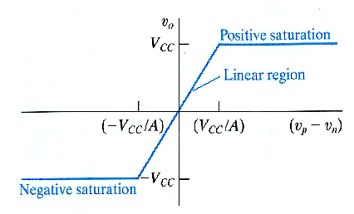
Terminal Voltages and Currents
The terminal behavior of the op amp as linear circuit element is characterized by constraints on the input voltages and input currents.
Voltage transfer characteristic:
When the magnitude of the input voltage difference (|v_{p} – v_{n}|) is small, the op amp behaves as a linear device, as the output voltage is a linear function of the input voltages (the output voltage is equal to the difference in its input voltages times the gain, A.

Slide 13
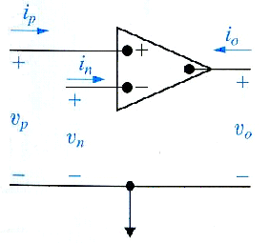
Terminal Voltages and Currents
For ideal op amp:
Input voltage constraint:
Input current constraint:
Apply Kirchhoff’s current law
Even though the current at the input terminal is negligible, there are still appreciable current at the output terminal.

Slide 14
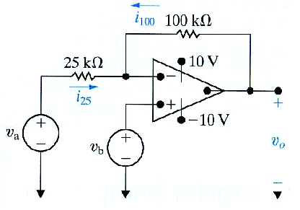
Example 1
Calculate v₀ if v_{a} = 1 V and v_{b} = 0 V.
Calculate v₀ if v_{a} = 1 V and v_{b} = 2 V.
If v_{a} = 1.5 V , specify the range of v_{b} that avoids amplifier saturation.

Slide 15

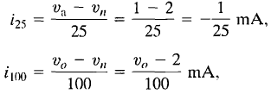
Sol. of Example 1
a) A negative feedback path exists from the op amp's output to its inverting input through the 100 kΩ resistor, → assume the op amp is working in linear operating region. ➔ write a node-voltage equation at the inverting input terminal. The voltage at the inverting input terminal is 0, as v_{p} = v_{b} = 0 from the connected voltage source, and v_{n} = v_{p} from the voltage constraint. The node-voltage equation at v_{n} is: i₂₅ + i₁₀₀ = i_{n}
i₂₅ = (v_{a} - v_{n})/25 = 1/25 mA
i₁₀₀ = (v_{o} - v_{n})/100 = v_{o}/100 mA
The current constraint requires i_{n} = 0. Substituting the values for the three currents into the node-voltage equation, we obtain
v_{o} = - 4 V
b) V_{p} = v_{b} = v_{n} = 2 V
i₂₅ = - i₁₀₀
v_{o} = 6 V

Slide 16


Sol. of Example 1
c) v_{n} = v_{p} = v_{b}, and i₂₅ = -i₁₀₀
v_{a} = 1.5 V
Solving for v_{b} as a function of v_{o} gives
Now, if the amplifier is to be within the linear region of operation,
-10 V ≤ v_{o} ≤ 10 V.
Substituting these limits on vo into the expression for v_{b}, we see that v_{b} is limited to
-0.8 V ≤ v_{b} ≤ 3.2 V.

Slide 17
The Basic Inverting Amplifier
Consequences of the Ideal
Infinite input resistance means the current into the inverting (–) input is zero:
i– = 0
Infinite gain means the difference between v₊ and v– is zero:
v₊ – v– = 0
R₂
R₁
–
V_{in}
+
–
+
+
V_{out}
–

Slide 18
The Basic Inverting Amplifier
Solving the Amplifier Circuit
Apply KCL at the inverting (–) input:
i₁ + i₂ + i– =0
R₂
V_{out}
i₂
R₁
V_{in}
V–
–
i₁
i–

Slide 19

The Basic Inverting Amplifier
Solve for V_{out}
From KCL
Thus, the amplifier gain is

Slide 20
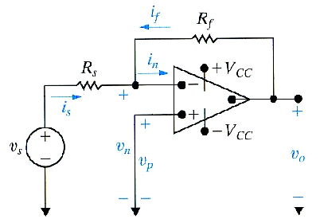
The Inverting Amplifier Circuit
The output voltage is an inverted, scaled replica of the input.
R_{f} is negative feedback of the circuit.
Upper limit on the gain:

Slide 21
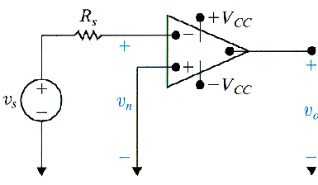
The Inverting Amplifier Circuit
When R_{f} is removed, the feedback path is opened and the amplifier is called open loop.
-Av_{s}
A is called the open-loop gain of the op amp
The negative sign in the equation indicates an inversion of the output signal with respect to the input as it is 180º out of phase.

Slide 22
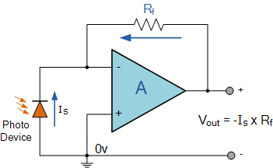
The Inverting Amplifier Circuit
Transresistance Amplifier Circuit
Application of an inverting amplifier is that of a "transresistance amplifier" circuit. A "transimpedance amplifier", is basically a current-to-voltage converter (Current "in" and Voltage "out"). They can be used in low-power applications to convert a very small current generated by a photo-diode or photo-detecting device etc, into a usable output voltage which is proportional to the input current.
The output voltage is proportional to the amount of input current generated by the photo-diode.

Slide 23
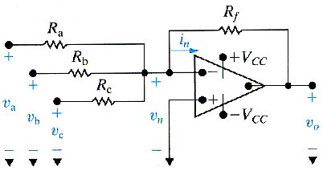
The Summing Amplifier Circuit
The output voltage of a summing amplifier is an inverted, scaled sum of the voltages applied to the input of the amplifier.

Slide 24
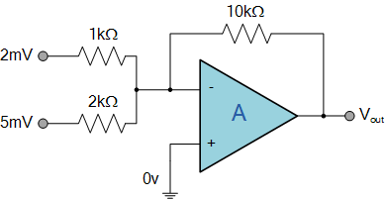

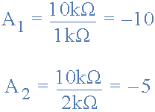

Example 3.1:
Find the output voltage of the following Summing Amplifier circuit
Solution:
Using the previously found formula for the gain of the circuit
we can now substitute the values of the resistors in the circuit as follows,

Slide 25
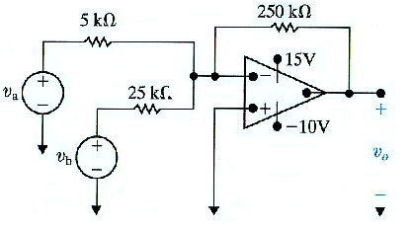
Example 3.2
Find v₀ with v_{a} =0.1 V and v_{b} = 0.25 V.
If v_{b} = 0.25 V, how large can v_{a} be before the op amp saturates.
If v_{a} = 0.1 V, how large can v_{b} be before the op amp saturates.
Repeat (a), (b), and (c) with the polarity of v_{b} reversed.

Slide 26
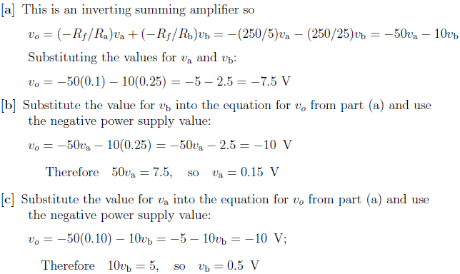
Sol. of example 3

Slide 27
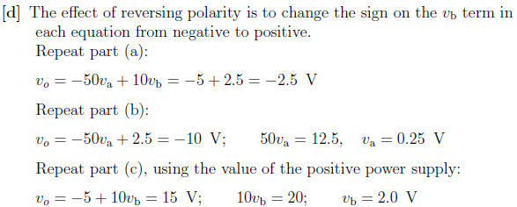
Sol. of example 3

Slide 28
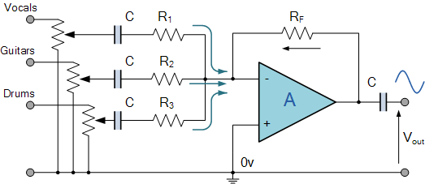
Summing Amplifier Applications
Summing Amplifier Audio Mixer
If the input resistances of a summing amplifier are connected to potentiometers the individual input signals can be mixed together by varying amounts.

Slide 29
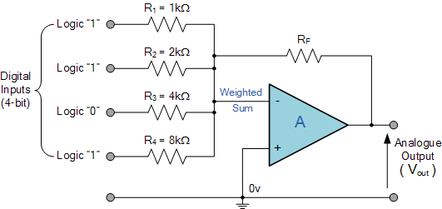
Summing Amplifier Applications
Digital to Analogue Converter (DAC summing amplifier circuit)
Another useful application of a Summing Amplifier is as a weighted sum digital-to-analogue converter. If the input resistors, Rin of the summing amplifier double in value for each input, for example, 1kΩ, 2kΩ, 4kΩ, 8kΩ, 16kΩ, etc, then a digital logical voltage, either a logic level "0" or a logic level "1" on these inputs will produce an output which is the weighted sum of the digital inputs. Consider the circuit below.

Slide 30
The Non-Inverting Amplifier
+
–
+
v_{in}
+
–
v_{out}
R₂
R₁
–

Slide 31
The Non-Inverting Amplifier
KCL at the Inverting Input
+
–
+
+
–
i–
v_{in}
v_{out}
i₁
i₂
R₂
R₁
–

Slide 32
The Non-Inverting Amplifier
Solve for v_{out}
Hence, the non-inverting amplifier has a gained output (> unity) relative to the resistance ratio

Slide 33
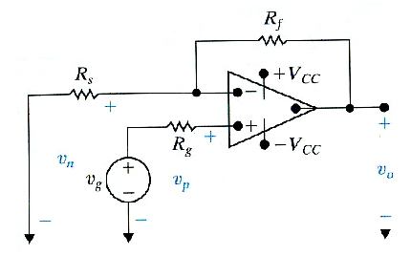
The Non-inverting Amplifier Circuit
Requirement for operation in the linear region:

Slide 34
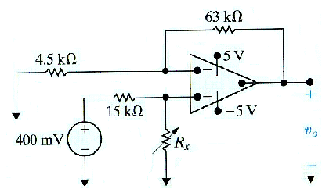
Example 4
(a) Find the output voltage when R_{x} = 60 kΩ
(b) How large can R_{x} be before the amplifier saturates.

Slide 35
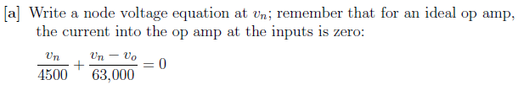
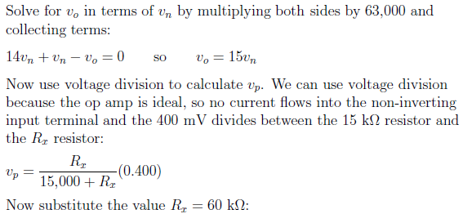
Sol. of example 4

Slide 36
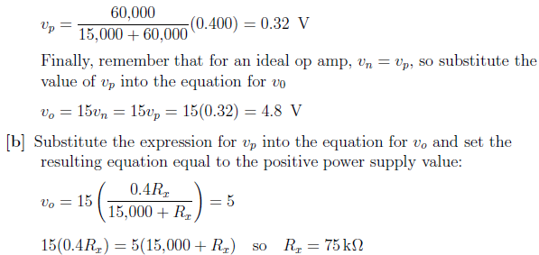
Sol. of example 4

Slide 37
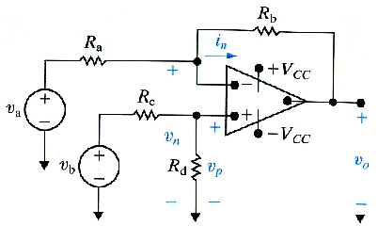
The Difference Amplifier Circuit
(*)
If set
then
The output voltage of a difference amplifier is a scaled replica of the difference between the two input voltages. The scaling is controlled by the external resistors.

Slide 38
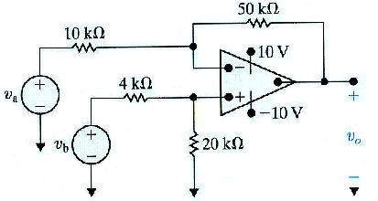
Example 5
In the difference amplifier shown, v_{b} = 4 V. What range of values for v_{a} will result in linear operation.
Repeat (a) with 20 kΩ resistor decreased to 8 kΩ

Slide 39
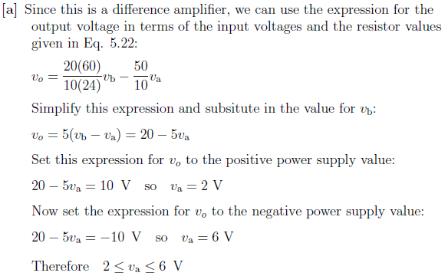
Sol. of example 5
(*)

Slide 40
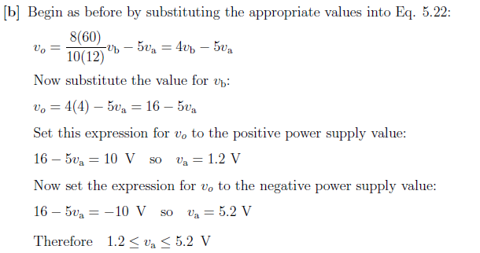
Sol. of example 5
(*)

Slide 41
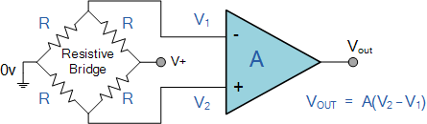
The Difference Amplifier Circuit: Applications
Bridge Amplifier
The standard Differential Amplifier circuit now becomes a differential voltage comparator by "Comparing" one input voltage to the other.
By connecting one input to a fixed voltage reference set up on one leg of the resistive bridge network and the other to either a "Thermistor" or a "Light Dependant Resistor" the amplifier circuit can be used to detect either low or high levels of temperature or light as the output voltage becomes a linear function of the changes in the active leg of the resistive bridge.

Slide 42
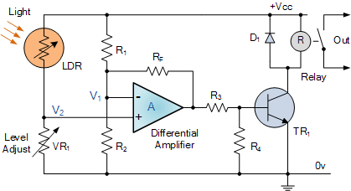
The Difference Amplifier Circuit: Applications
The circuit acts as a light-activated switch → turns the output relay either "ON" or "OFF" as the light level detected by the LDR resistor exceeds or falls below a pre-set value at V2 determined by the position of VR1. A fixed voltage reference is applied to the inverting input terminal V1 via the R1 - R2 voltage divider network and the variable voltage (proportional to the light level) applied to the non-inverting input terminal V2. It is also possible to detect temperature using this type of circuit by
simply replacing the Light Dependant Resistor (LDR) with a thermistor. By interchanging the positions of VR1and the LDR, the circuit can be used to detect either light or dark, or heat or cold using a thermistor.
Light Activated Switch:

Slide 43




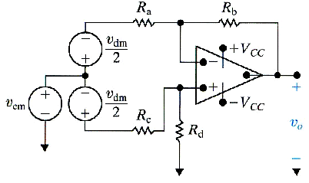
The difference amplifier – Another perspective
An ideal differential amplifier has zero common mode gain and non-zero (usually large) differential mode gain.
In practical applications, the differential mode signal contains information of interest, whereas the common mode signal is the noise found in all electric signals.

